Slide 1
BECE206L - Analog Circuits
Dr. Sangeetha R.G
Professor
School of Electronics Engineering (SENSE)

Slide 2
Module I | DC and AC analysis of amplifiers (9)
BJT Circuits: DC biasing, AC coupling and small-signal analysis of amplifiers, Frequency response of a CE amplifier, the three frequency bands, Unity gain frequency, Miller Capacitance, Multistage amplifiers. MOSFET Circuits: DC biasing, AC coupling and small-signal analysis of amplifiers, Frequency response of a CS amplifier, Unity gain frequency, Miller Capacitance, Multistage amplifiers.

Slide 3
DC ANALYSIS OF TRANSISTOR CIRCUITS
Objective: Understand and become familiar with the dc analysis and design techniques of bipolar transistor circuits.

Slide 4
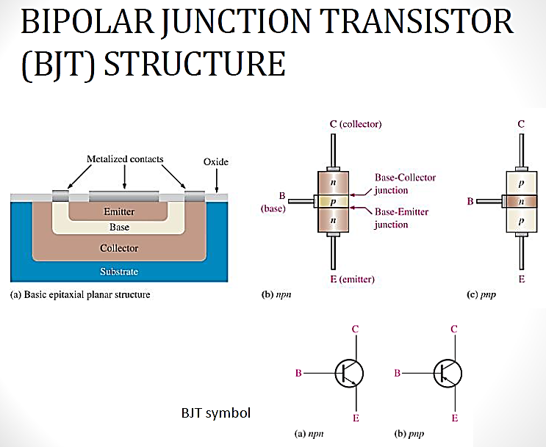

Slide 5
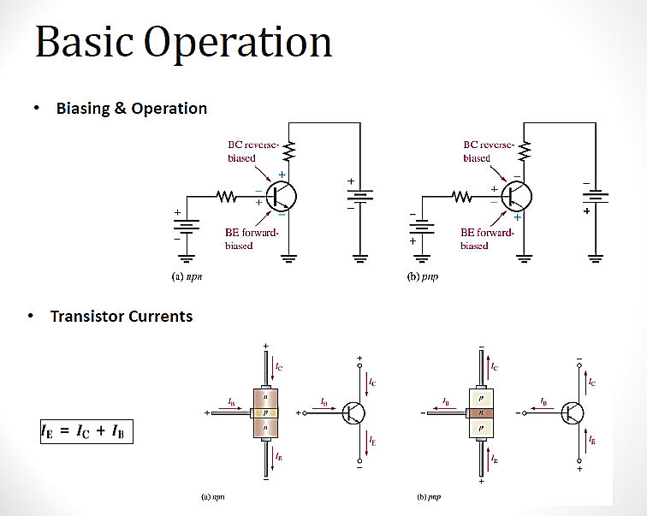

Slide 7
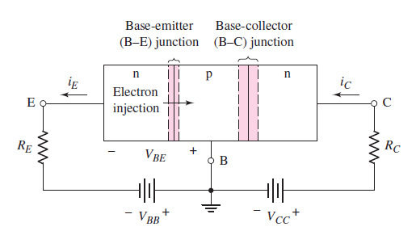
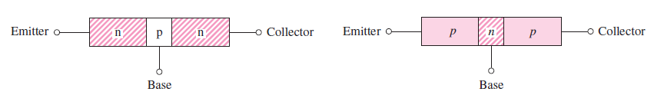
Bipolar Junction Transistor (BJT)
The bipolar junction transistor (BJT) has three separately doped regions and contains two pn junctions. A single pn junction has two modes of operation—forward bias and reverse bias. The bipolar transistor, with two pn junctions, therefore has four possible modes of operation, depending on the bias condition of each pn junction.
Active
Saturation
Cutoff
Reverse Active
Simple geometry of bipolar transistors: (a) npn and (b) pnp

Slide 8
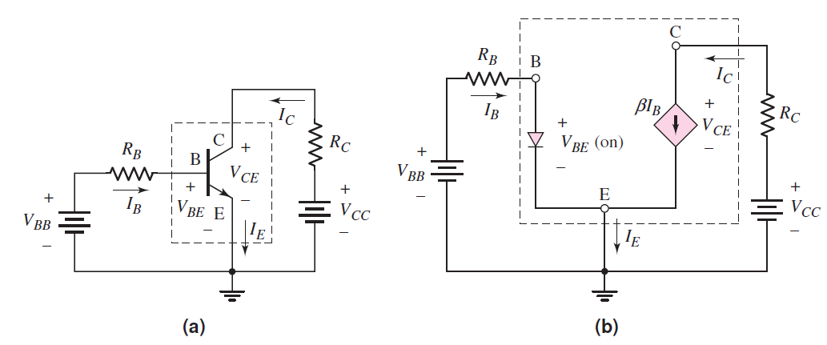
Common-Emitter Circuit
(a) Common-emitter circuit with npn transistor and (b) dc equivalent circuit. Transistor equivalent circuit is shown within the dotted lines

Slide 9
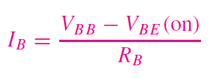
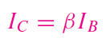

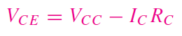
The base current
VBB > VBE (on), which means that IB > 0. When VBB < VBE (on), the transistor is cut off and IB = 0.
In the collector–emitter portion of the circuit

Slide 10
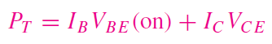
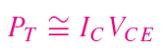
The power dissipated in the transistor is given by
In most cases, IC IB and VCE > VBE (on) so that a good first approximation of the power dissipated is given as

Slide 11
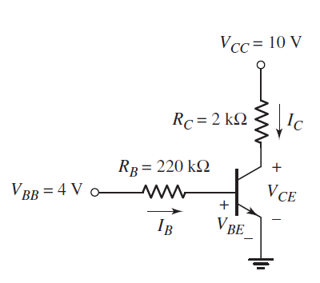
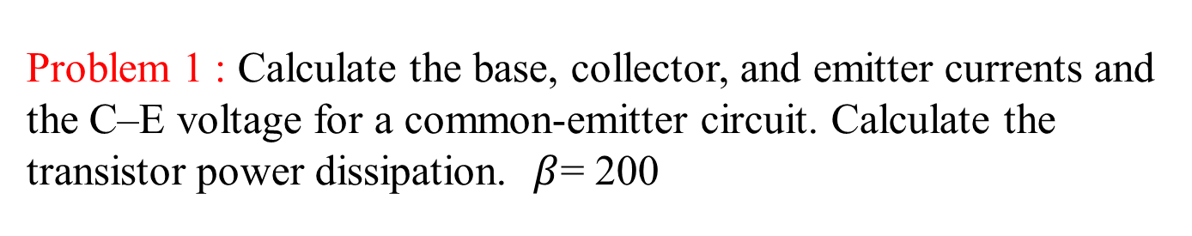
Problem 1 : Calculate the base, collector, and emitter currents and the C–E voltage for a common-emitter circuit. Calculate the transistor power dissipation. $β$= 200

Slide 13
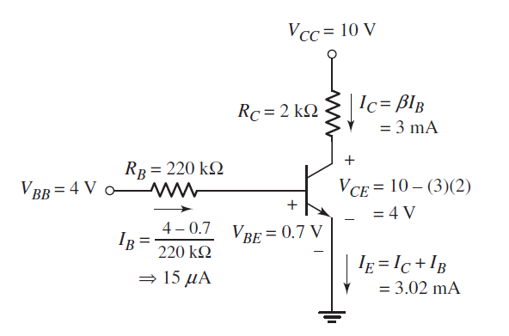
Solution

Slide 14
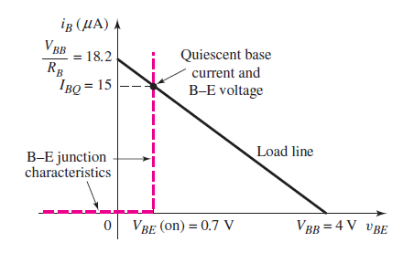
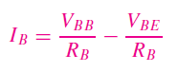
Load Line and Modes of Operation
The input load line is obtained from Kirchhoff’s voltage law equation around the B–E loop
(a) Base–emitter junction piecewise linear i–v characteristics and the input load line

Slide 15
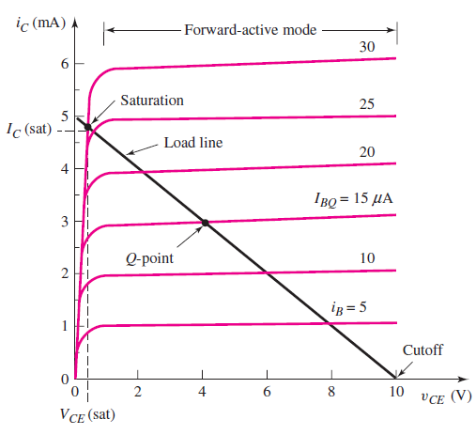
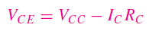
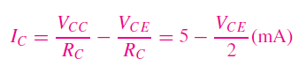
The load line is found by writing Kirchhoff’s voltage law equation around the C–E loop
The two end points of the load line are found by setting IC = 0, yielding VCE = VCC = 10 V, and by setting VCE = 0, yielding IC = VCC/RC = 5 mA.
(b) common-emitter transistor characteristics and the collector–emitter load line showing the Q-point for the circuit

Slide 16
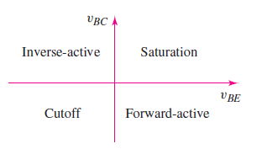
Bias conditions for the four modes of operation of an npn transistor
If vBE > 0 (forward-biased junction) and vBC < 0 (reverse biased junction), the transistor is biased in the forward-active mode.
If both junctions are zero or reverse biased, the transistor is in cutoff.
If both junctions are forward biased, the transistor is in saturation.
If the B–E junction is reverse biased and the B–C junction is forward biased, the transistor is in the inverse-active mode.

Slide 17
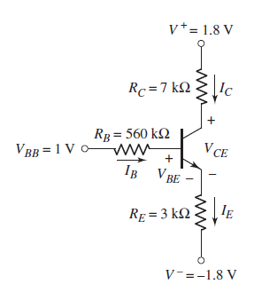
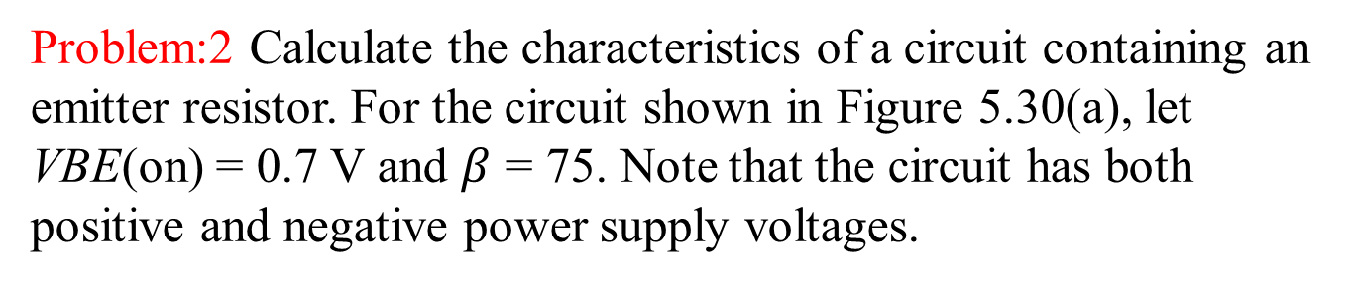
Problem:2 Calculate the characteristics of a circuit containing an emitter resistor. For the circuit shown in Figure 5.30(a), let VBE(on) = 0.7 V and $β$ = 75. Note that the circuit has both positive and negative power supply voltages.

Slide 18
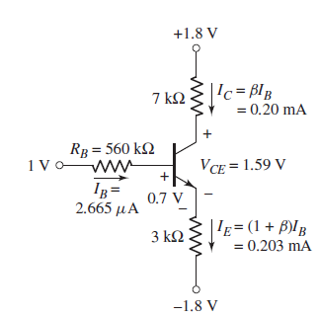
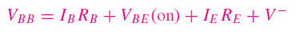
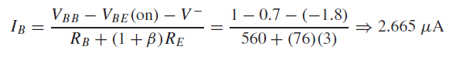
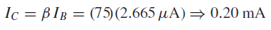
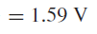
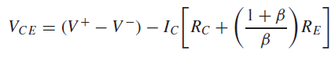
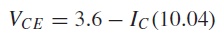
The collector and emitter currents are
The collector–emitter voltage is
The relationship between the collector and emitter currents

Slide 19
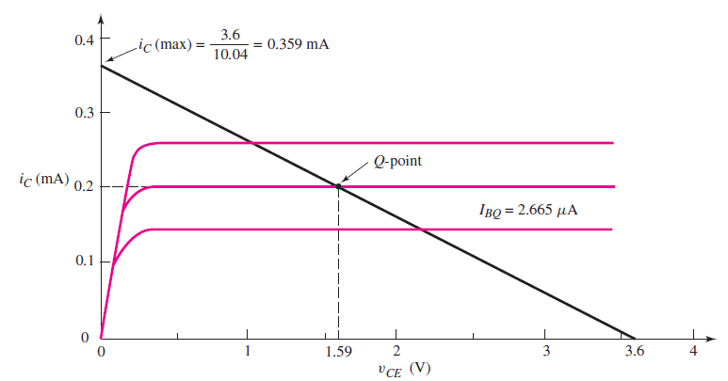
Load line and Q-point for the circuit
Since the C–E voltage is 1.59 V, VCE > VBE (on) and the transistor is biased in the forward-active mode

Slide 20
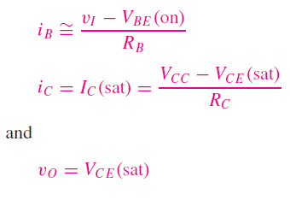
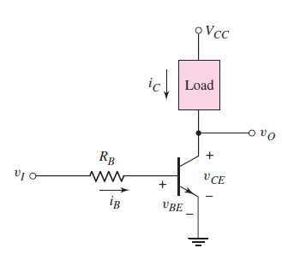
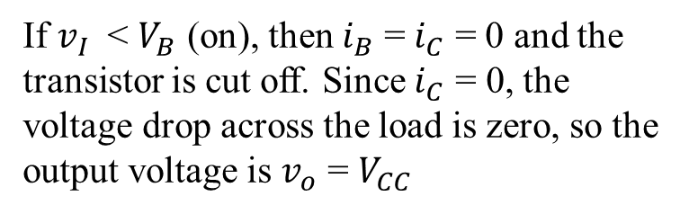
BASIC TRANSISTOR APPLICATIONS
Objective: Examine three applications of bipolar transistor circuits: a switch circuit, digital logic circuit, and an amplifier circuit.
If $v_{I}$ < $V_{B}$ (on), then $i_{B}$ = $i_{C}$ = 0 and the transistor is cut off. Since $i_{C}$ = 0, the voltage drop across the load is zero, so the output voltage is $v_{o}$ = $V_{CC}$
An npn bipolar inverter circuit
used as a switch

Slide 21
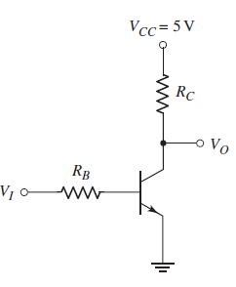
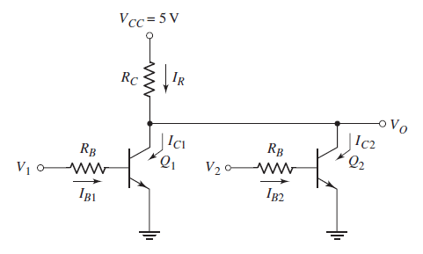
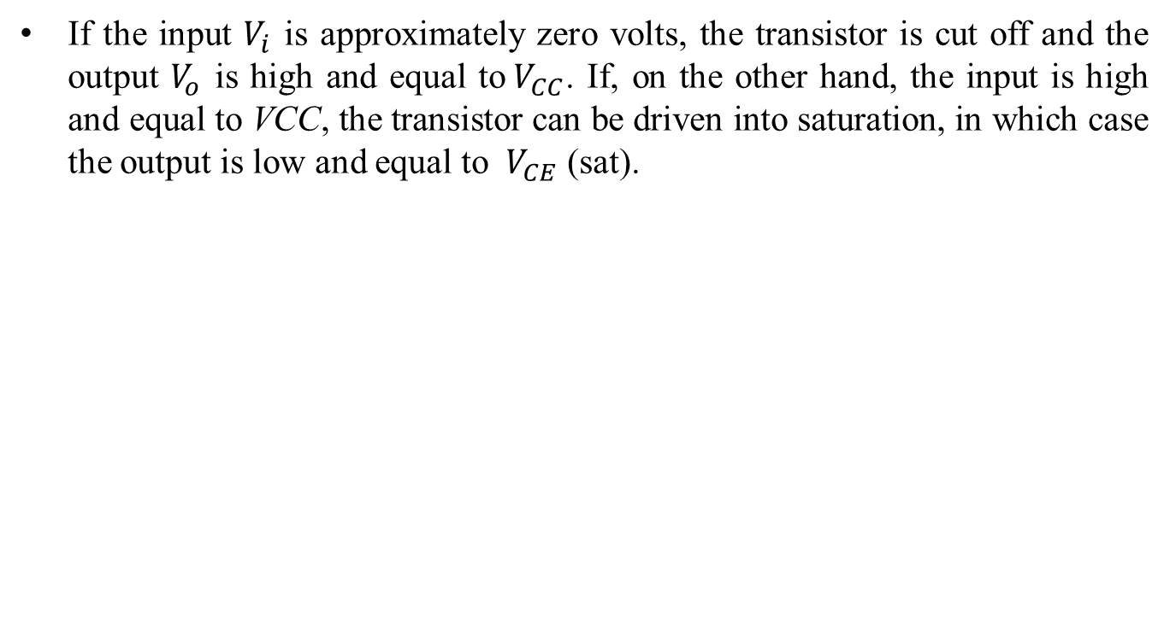
Digital Logic
If the input $V_{i}$ is approximately zero volts, the transistor is cut off and the output $V_{o}$ is high and equal to${ V}_{CC}$. If, on the other hand, the input is high and equal to VCC, the transistor can be driven into saturation, in which case the output is low and equal to ${ V}_{CE}$ (sat).
NOR logic gate
Inverter circuit

Slide 22
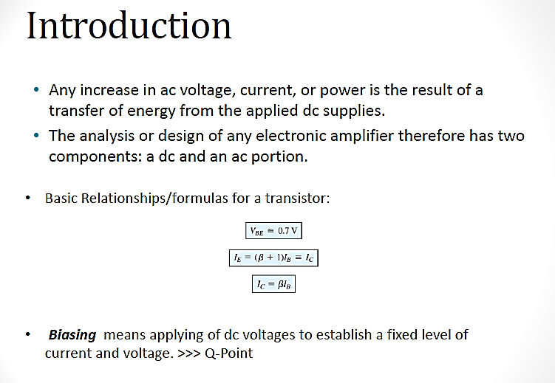
BJT BIASING

Slide 23
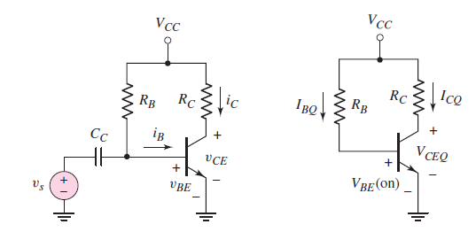
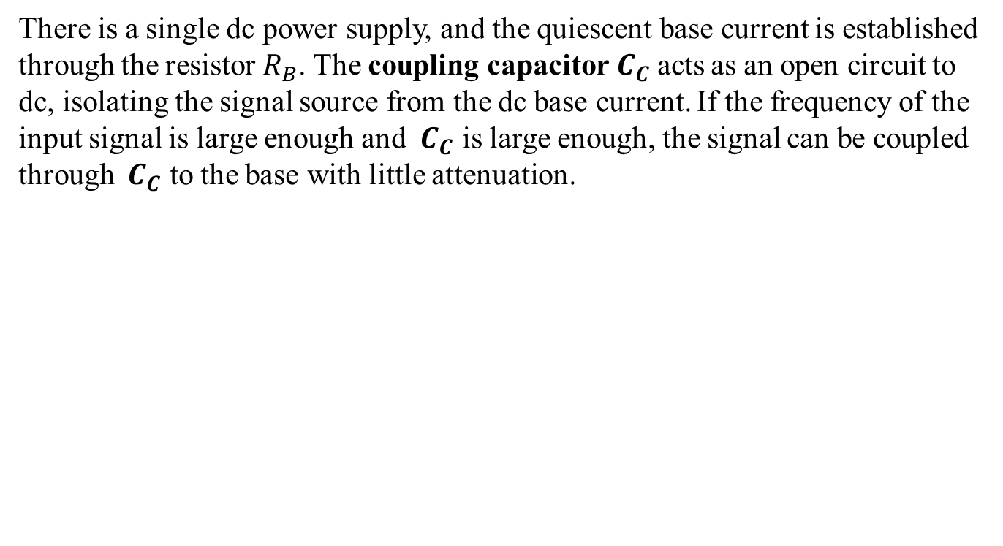
BIPOLAR TRANSISTOR BIASING
There is a single dc power supply, and the quiescent base current is established through the resistor $R_{B}$. The coupling capacitor${ C}_{C}$acts as an open circuit to dc, isolating the signal source from the dc base current. If the frequency of the input signal is large enough and ${ C}_{C}$ is large enough, the signal can be coupled through ${ C}_{C}$ to the base with little attenuation.
Common-emitter circuit with a single bias resistor in the base
DC equivalent circuit

Slide 24
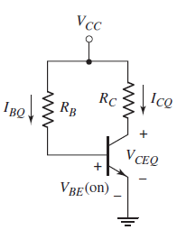
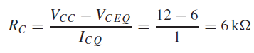
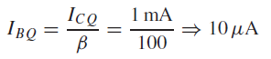
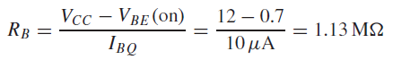
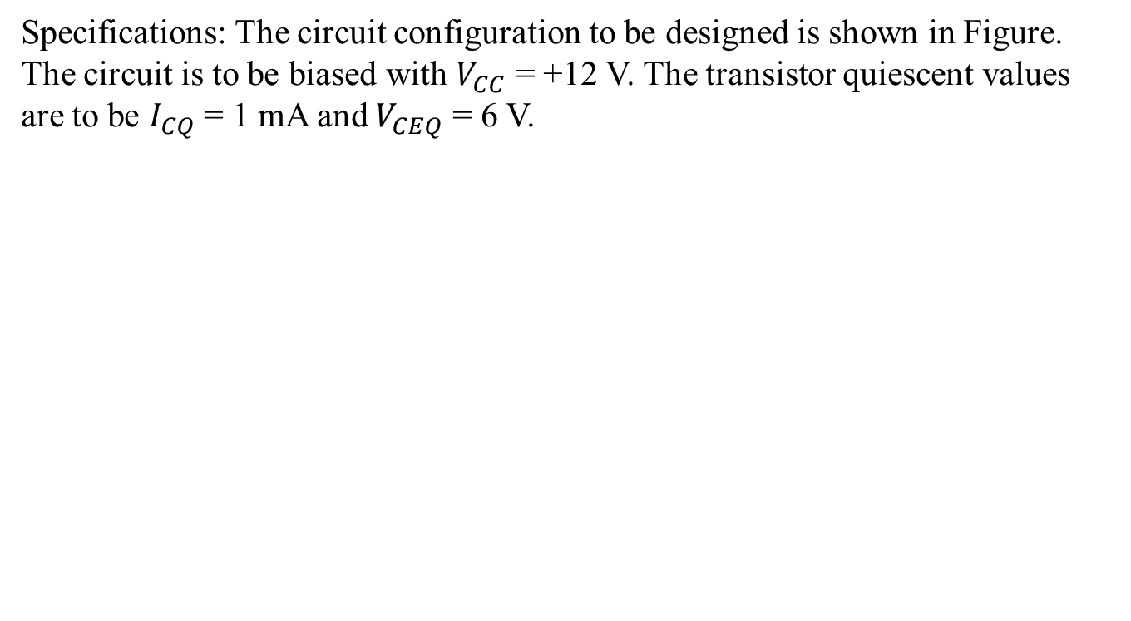
Problem: Design a circuit with a single-base resistor to meet a set of specifications.
Specifications: The circuit configuration to be designed is shown in Figure. The circuit is to be biased with $V_{CC}$ = +12 V. The transistor quiescent values are to be $I_{CQ}$ = 1 mA and $V_{CEQ}$ = 6 V.
The collector resistor is found from
The base current is
The base resistor is determined to be

Slide 25
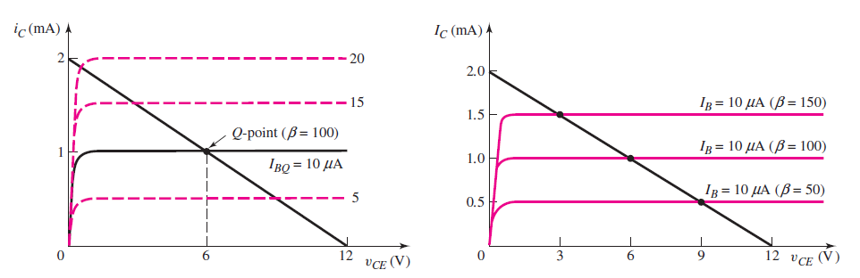
Transistor characteristics, load line, and Q-point for this set of conditions
Transistor characteristics and load line for the circuit
load line and changes in the Q-point for 50, 100, and 150.

Slide 26
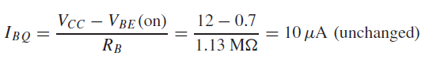
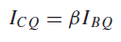
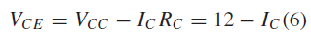
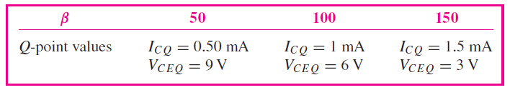
Trade-offs: In this example, we will assume that the resistor values are fixed and will investigate the effects of the variation in transistor current gain .
The base current is given by
The base current for this circuit configuration is independent of the transistor current gain.
The collector current is
and the load line is found from
In this circuit configuration with a single base resistor, the Q-point is not stabilized against variations in β; as β changes, the Q-point varies significantly.

Slide 27
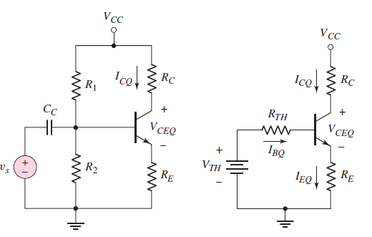
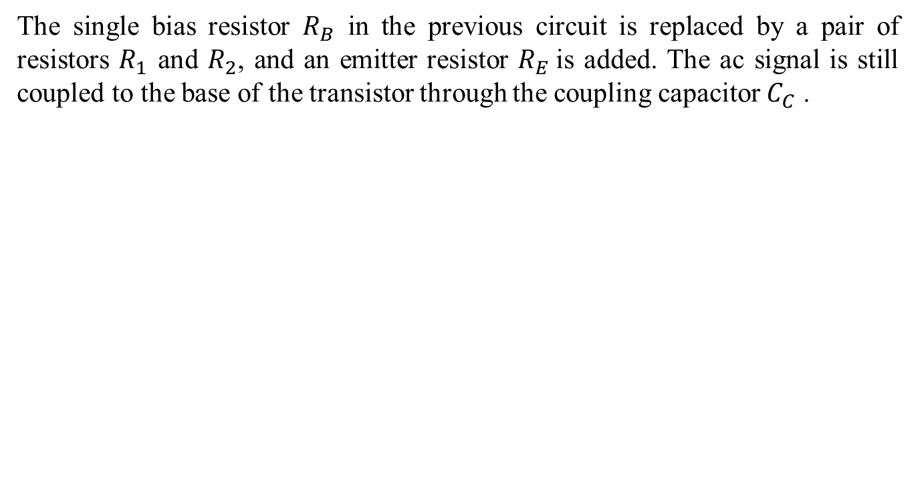
Voltage Divider Biasing and Bias Stability
The single bias resistor $R_{B}$ in the previous circuit is replaced by a pair of resistors $R_{1}$ and $R_{2}$, and an emitter resistor $R_{E}$is added. The ac signal is still coupled to the base of the transistor through the coupling capacitor $C_{C}$ .
A common-emitter circuit with an emitter resistor and voltage divider bias
circuit in the base
dc circuit with a Thevenin equivalent base circuit

Slide 28




Applying Kirchhoff’s law around the B–E loop, we obtain
If the transistor is biased in the forward-active mode, then
The base current
The collector current is then

Slide 29



Problem: Analyze a circuit using a voltage divider bias circuit, and determine the change in the Q-point with a variation in when the circuit contains an emitter resistor. For the circuit given in Figure, let $R_{1}$ = 56 k, $R_{2}$ = 12.2 k, $R_{C}$ = 2 k, $R_{E}$ = 0.4 k, $V_{CC}$ = 10 V, $V_{BE}$(on) = 0.7 V, and $β$= 100
Using the Thevenin equivalent circuit
Writing the Kirchhoff voltage law equation around the B–E loop,

Slide 30



The collector current is
The emitter current is
The quiescent C–E voltage is then
These results show that the transistor is biased in the active region.
If the current gain of the transistor were to decrease to $β$ = 50 or increase to
$β$ = 150, we obtain the following results:

Slide 31


Load lines and Q-point values
The voltage divider circuit of $R_{1}$ and $R_{2}$ can bias the transistor in its active region using resistor values in the low kilo-ohm range. In contrast, single resistor biasing requires a resistor in the mega-ohm range. In addition, the change in $I_{CQ}$ and $V_{CEQ}$ with a change $β$in has been substantially reduced compared to the change shown in Figure. Including an emitter resistor RE has tended to stabilize the Q-point. This means that including the emitter resistor helps to stabilize the Q-point with respect to variations in $β$.

Slide 32


Problem: Design a bias-stable pnp transistor circuit to meet a set of specifications
Assume transistor parameters of $β$ = 80 and $V_{BE}$(on) = 0.7 V. Standard
resistor values are to be used in the final design.

Slide 33



Slide 34



Slide 35

The AC Equivalent Circuit
Common-emitter transistor characteristics, dc load line, and sinusoidal variation in base current, collector current, and collector–emitter voltage Figure
A common-emitter circuit
with a time-varying signal source in
series with the base dc source

Slide 36



From the concept of small signal, all the time-varying signals shown in Figure. will be linearly related and are superimposed on dc values
If the signal source, $v_{s}$, is zero, then the base-emitter loop equation is
Taking into account the time-varying signals, we find the base–emitter loop
equation is

Slide 37




Rearranging terms, we find
which is the base-emitter loop equation with all dc term effectively set equal to zero.
The Collector–Emitter Loop: Again, if the signal source, vs , is zero, then the collector-emitter loop equation is
Taking into account the time-varying signals, the collector-emitter loop equation becomes
Rearranging terms, we find
which is the collector–emitter loop equation with all dc terms set equal to zero.

Slide 38

AC equivalent circuits
The ac equivalent circuit of the common-emitter circuit

Slide 39




Small-Signal Hybrid- $π$Equivalent Circuit of the Bipolar Transistor
The base current versus base–emitter voltage characteristic, with small time-varying signals superimposed at the Q-point. Since the sinusoidal signals are small, we can treat the slope at the Q-point as a constant, which has units of conductance. The inverse of this conductance is the small-signal resistance defined as $r_{π}$ . We can then relate the small-signal input base current to the small-signal input voltage by
The BJT as a small-signal, two-port
network

Slide 40


Slide 41

where $\frac{1}{r_{π}}$ is equal to the slope of the $i_{B} −v_{BE}$ curve
The resistance $r_{π}$is called the diffusion resistance or base–emitter input resistance.
We see that $r_{π}$ is a function of the Q-point parameters.

Slide 42


Output Collector–Emitter Port
If we initially consider the case in which the output collector current is independent of the collector–emitter voltage, then the collector current is a function only of the base–emitter voltage,

Slide 43



The term $I_{s}\exp{\frac{V_{BE}}{V_{T}}}$ evaluated at the Q-point is just the quiescent collector current.
The term $I_{CQ}/V_{T}$ is a conductance. Since this conductance relates a current in the
collector to a voltage in the B–E circuit, the parameter is called a transconductance
and is written
The small-signal transconductance is also a function of the Q-point parameters and
is directly proportional to the dc bias current. The variation of transconductance with
quiescent collector current will prove to be useful in amplifier design.

Slide 44






Small-signal hybrid- equivalent circuit
A simplified small-signal hybrid- equivalent circuit for the npn transistor.
Alternative Form of Equivalent Circuit
BJT small-signal equivalent circuit using
the common-emitter current gain.

Slide 45






Common-Emitter Current Gain
The dependent current source is then given by $g_{m}v_{π}$ .
The dependent current $g_{m}v_{π}$ flows through $R_{C}$, producing a negative collector–emitter voltage, or
The small-signal voltage gain, Av = Vo/Vs , of the circuit is defined as the ratio of output signal voltage to input signal voltage.
from the input portion of the circuit
The small-signal voltage gain is then

Slide 46


Problem: Calculate the small-signal voltage gain of the bipolar transistor circuit shown in Figure
DC Solution: We first do the dc analysis to find the Q-point values. We obtain
AC Solution: The small-signal hybrid- parameters are

Slide 47

The small-signal voltage gain is determined using the small-signal equivalent circuit
Comment: We see that the magnitude of the sinusoidal output voltage is 11.4 times the magnitude of the sinusoidal input voltage.

Slide 48


Input and Output Resistance
From the hybrid- equivalent circuit in Figure 6.13(a), the input resistance looking into the base terminal of the transistor, denoted by $R_{ib}=r_{π}$.
To find the output resistance, set all independent sources equal to zero. So, in Figure, we set $v_{π}$ = 0 which implies that $g_{m}v_{π}$ = 0. A zero-valued current source means an open circuit. The output resistance looking back into the collector terminal of the
transistor, denoted by $R_{oc}$, is $R_{oc}$ = $r_{o}$.
These two parameters affect the loading characteristics of the amplifier.

Slide 49

Basic Common-Emitter Amplifier Circuit
A common-emitter circuit with a voltage-divider biasing circuit and a coupling capacitor

Slide 50




If the signal source is a sinusoidal voltage at frequency f, then the magnitude of the capacitor impedance is $\left|Z_{C}\right|=\frac{1}{2πf C_{C}}$. For example, assume that $C_{C}$ = 10 μF and f = 2 kHz. The magnitude of the capacitor impedance is then
The magnitude of this impedance is in general much less than the Thevenin resistance at the capacitor terminals, which in this case is$R_{1}\left|\left|R_{2}\right|\right|r_{π}$. We can therefore assume that the capacitor is essentially a short circuit to signals with frequencies greater than 2 kHz.
The small-signal equivalent circuit, assuming the coupling capacitor is a short circuit

Slide 51





The output voltage is
The control voltage $V_{π}$ is found to be
The small-signal voltage gain is
The voltage across $R_{2}$ provides the base–emitter voltage to bias the transistor in the forward-active region. However, a slight variation in the resistor value or a slight variation in the transistor characteristics may cause the transistor to be biased in cutoff or saturation.

Slide 52

Circuit with Emitter Resistor
The Q-point was stabilized against variations in $β$ if an emitter resistor were included in the circuit
voltage gain of a circuit with $R_{E}$ will be less dependent on the transistor current gain $β$
An npn common-emitter circuit with an emitter resistor, a voltage-divider biasing circuit, and a coupling capacitor

Slide 53

The small-signal equivalent circuit of the circuit

Slide 54





The ac output voltage is
The resistance $R_{ib}$ is the input resistance looking into the base of the transistor.
In the common-emitter configuration that includes an emitter resistance, the
small-signal input resistance looking into the base of the transistor is $r_{π}$ plus the
emitter resistance multiplied by the factor (1 + $β$). This effect is called the resistance
reflection rule.
The input resistance to the amplifier is now

Slide 55



We can again relate $V_{in}$ to $V_{s}$ through a voltage-divider equation as
The small-signal voltage gain is
if $R_{i}≫R_{S}$and if $\left(1+β\right)R_{E}≫r_{π}$, then the small signal voltage gain is approximately

Slide 56



Problem: Determine the small-signal voltage gain and input resistance of a common-emitter circuit with an emitter resistor.
The transistor parameters are: $β$ = 100, $V_{BE}\left(on\right)$ = 0.7 V, and $V_{A}$ = ∞
DC Solution: From a dc analysis of the circuit, we can determine that $I_{CQ}$ = 2.16 mA and $V_{CEQ}$ = 4.81 V, which shows that the transistor is biased in the forward-active mode.

Slide 57


AC Solution: The small-signal hybrid- parameters are determined to be
The Early voltage is a parameter describing the variation of the transistor collector in the active or the saturation region of operation with the VCE

Slide 58


Slide 59

Frequency response

Slide 60







Series coupling capacitor

Slide 61



Parallel Load capacitor

Slide 62

Bode plot

Slide 63

Series and parallel capacitor

Slide 64

FREQUENCY RESPONSE: TRANSISTOR AMPLIFIERS WITH CIRCUIT CAPACITORS
Coupling Capacitor Effects
Common-emitter circuit with coupling capacitor
small-signal
equivalent circuit

Slide 65



Current–Voltage Analysis: The input current can be written as
To determine the input resistance to the base of the transistor, we multiplied the emitter resistance by the factor (1 + $β$).
Using a current divider, we determine the base current to be

Slide 66



The output voltage is given by
The small-signal voltage gain is

Slide 67

The corner frequency is

Slide 68


Problem: Calculate the corner frequency and maximum gain of a bipolar common emitter circuit with a coupling capacitor.
The parameters are: $R_{1}$ = 51.2 k, $R_{2}$ = 9.6 k, $R_{C}$ = 2 k, $R_{E}$ = 0.4 k, $R_{Si}$= 0.1 k, $C_{C}$ = 1 μF, and $V_{CC}$ = 10 V. The transistor parameters are: $V_{BE}$(on) = 0.7 V, $β$= 100, and $V_{A}$ = ∞.
From a dc analysis, the quiescent collector current is $I_{CQ}$ = 1.81 mA. The small-signal parameters are$g_{m}$= 69.6 mA/V and $r_{π}$ = 1.44 k.

Slide 69




Slide 70
Problem: Calculate the corner frequency and maximum gain of a bipolar common emitter circuit with a coupling capacitor.
The parameters are: $R_{1}$ = 51.2 k, $R_{2}$ = 9.6 k, $R_{C}$ = 2 k, $R_{E}$ = 0.4 k, $R_{Si}$= 0.1 k, $C_{C}$ = 1 μF, and $V_{CC}$ = 10 V. The transistor parameters are: $V_{BE}$(on) = 0.7 V, $β$= 100, and $V_{A}$ = ∞.
From a dc analysis, the quiescent collector current is $I_{CQ}$ = 1.81 mA. The small-signal parameters are$g_{m}$= 69.6 mA/V and $r_{π}$ = 1.44 k.

Slide 72


Coupling and Load Capacitors
Circuit with both a coupling and a load capacitor
small-signal
equivalent circuit

Slide 73





The lower corner frequency$f_{L}$is given by
where $τ_{S}$ is the time constant associated with the coupling capacitor $C_{C}$, and the upper corner frequency $f_{H}$ is given by
where $τ_{S}$ is the time constant associated with the coupling capacitor $C_{L}$
The related time constant is

Slide 74



The time constant related to $C_{L}$ is
The magnitude of the midband gain as

Slide 75

Bypass Capacitor Effects

Slide 76




Using the impedance reflection rule, the small-signal input current is
The total impedance in the emitter is multiplied by the factor (1 + $β$). The control
voltage is
and the output voltage is
the small-signal voltage gain

Slide 77





Expanding the parallel combination of $R_{E}$ and $\frac{1}{sC_{E}}$ and rearranging terms, we find
It can be written in terms of time constants as
circuit

Slide 78






the corner frequency due to $τ_{B}$ is
the corner frequency due to $τ_{B}$ is
Bode plot of the voltage gain magnitude for the circuit with an emitter bypass capacitor

Slide 79


Expanded Hybrid-π Equivalent Circuit

Slide 80




Slide 81



Slide 82




Slide 83

Problem:1

Slide 84


Miller Effect and Miller Capacitance
The Miller effect, or feedback effect, is a multiplication effect of Cμ in circuit applications.

Slide 85


Two-terminal network of capacitor Cμ

Slide 86



Thevenin equivalent
Norton equivalent
Small-signal equivalent circuit, including the two-port equivalent model of capictor Cμ

Slide 87


Case: 1
simplifying approximations.
Case: 2

Slide 88

Small-signal equivalent circuit, including approximations

Slide 89



Slide 90



Slide 91





